Slide 1

Toolkit Doc20 Shoulder
May 11, 2010

Slide 2
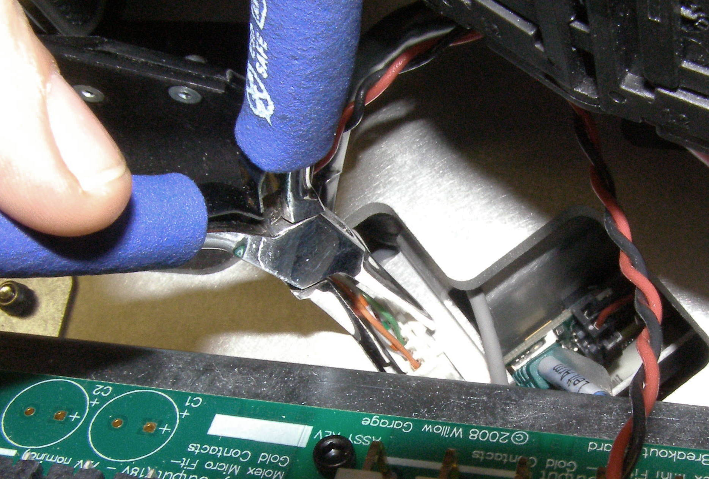
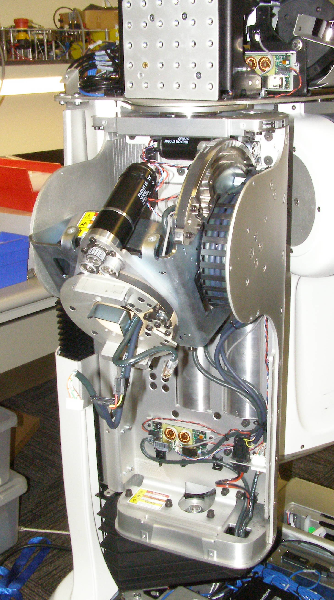
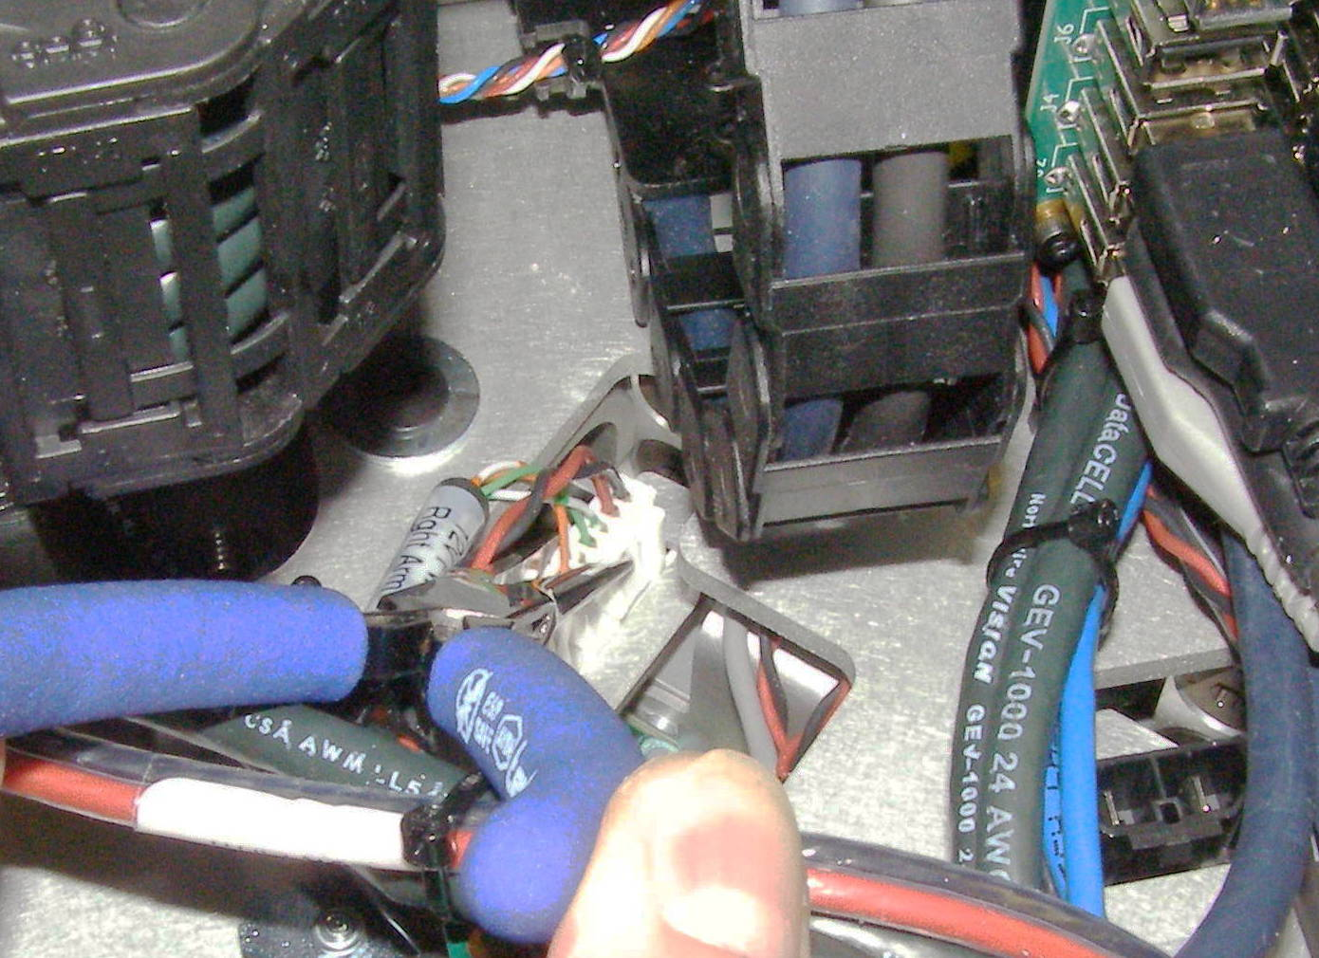
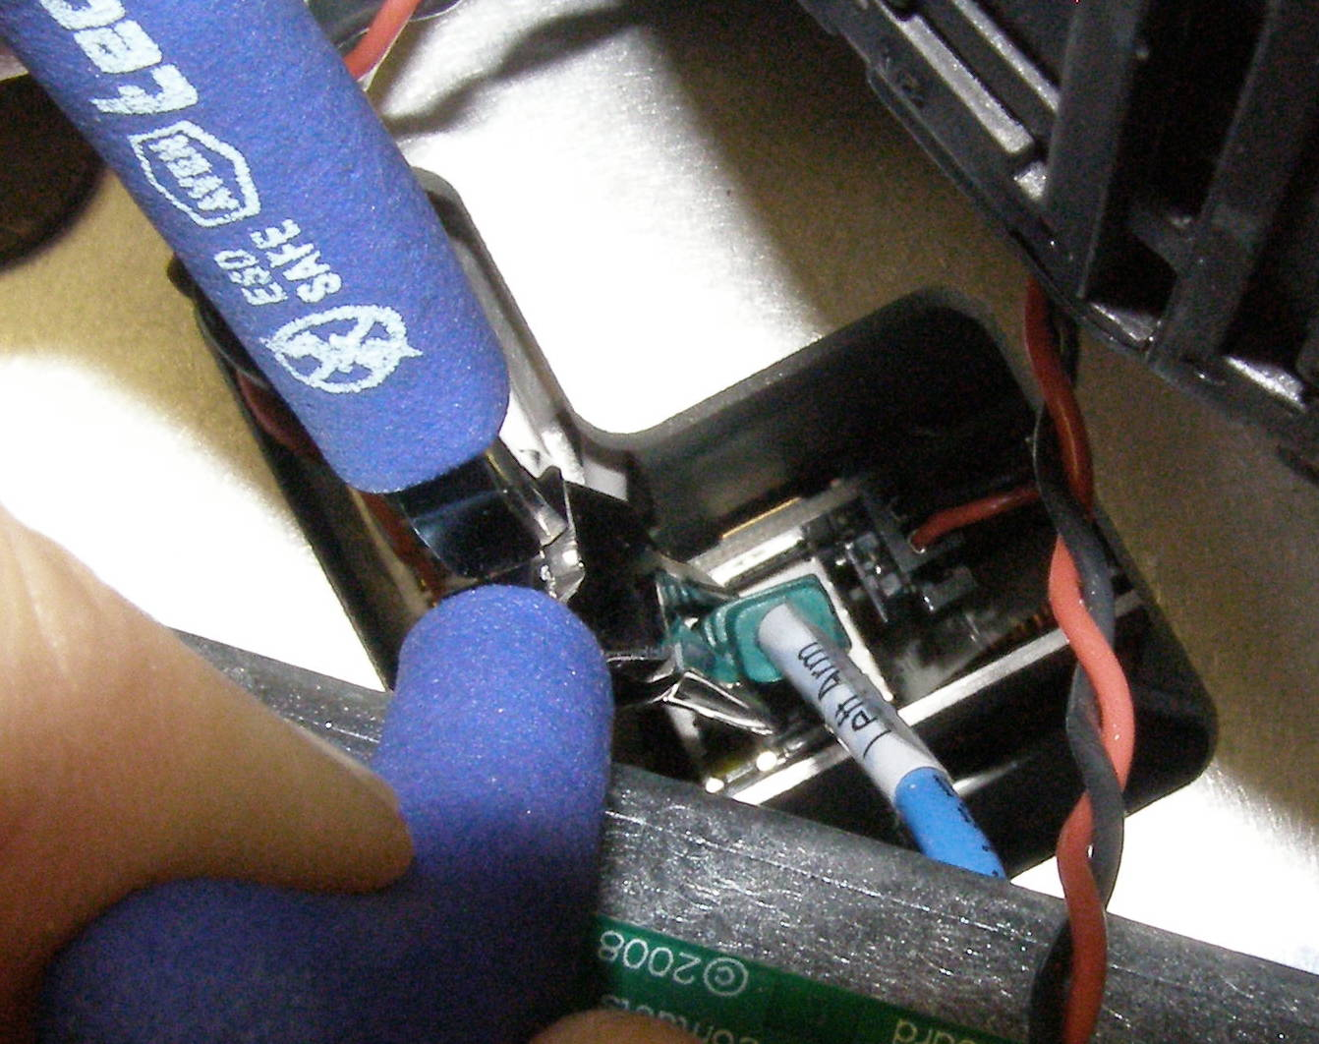
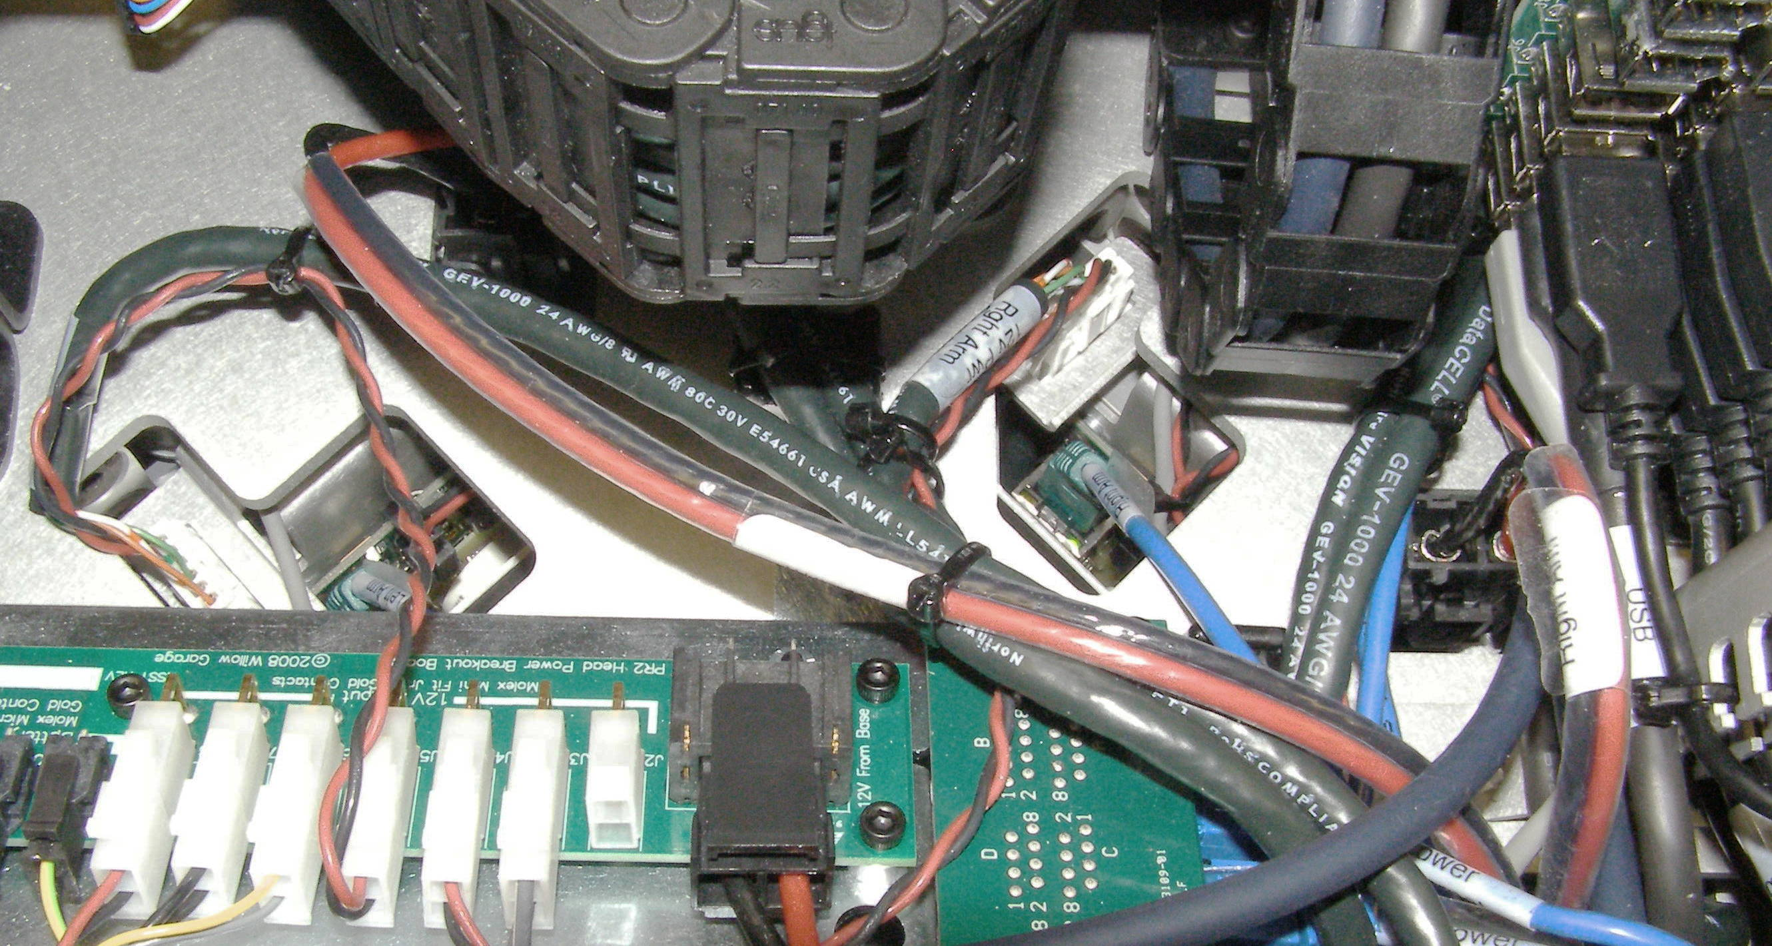
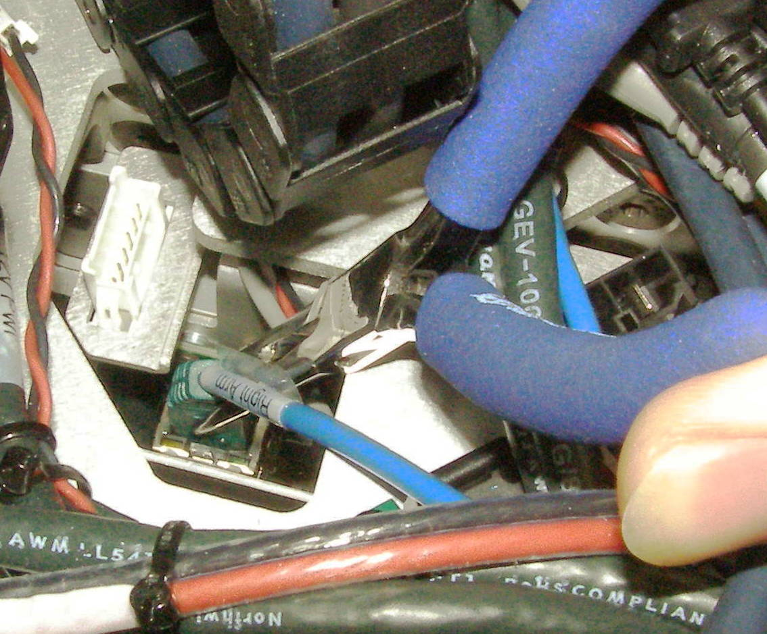
Shoulder Removal (1)
Shoulder, Removal - 4204 (requires 2 people)
  Remove Fore Arm + Gripper assembly first.
  Remove Trim pieces.
  Remove Upper Arm.
  Remove Shoulder covers. (Shoulder ready for removal 1)
  Disconnect 3 cables per Shoulder. You will need to use the Needle Nose pliers to release the latches for the connectors. The Right Shoulder connectors are on the Right side and the Left on the Left side. Both of the Power connectors (Red/Black wire) are hidden under cables or an energy chain. (Fig 2-7)
Fig 3
Fig 1
Fig 4
Fig 5
Secondary
Fig 7
Fig 2
Fig 6

Slide 3
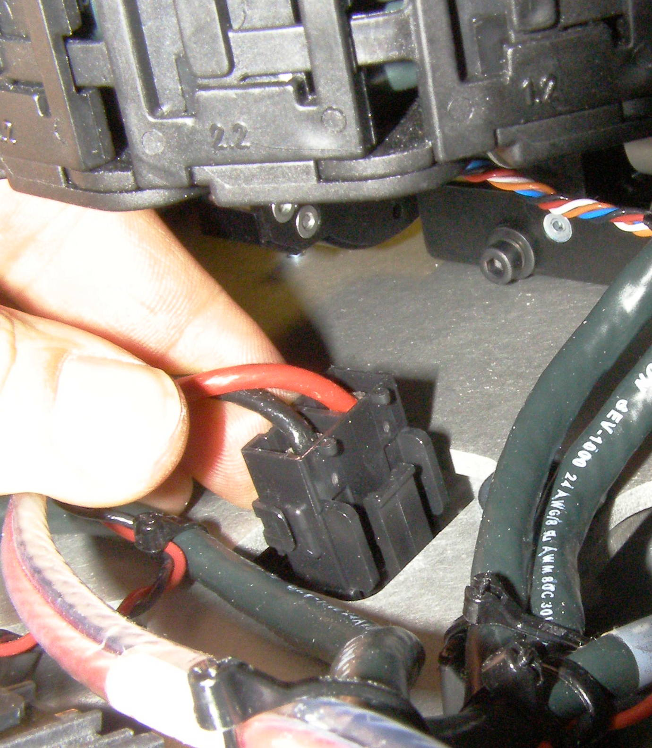
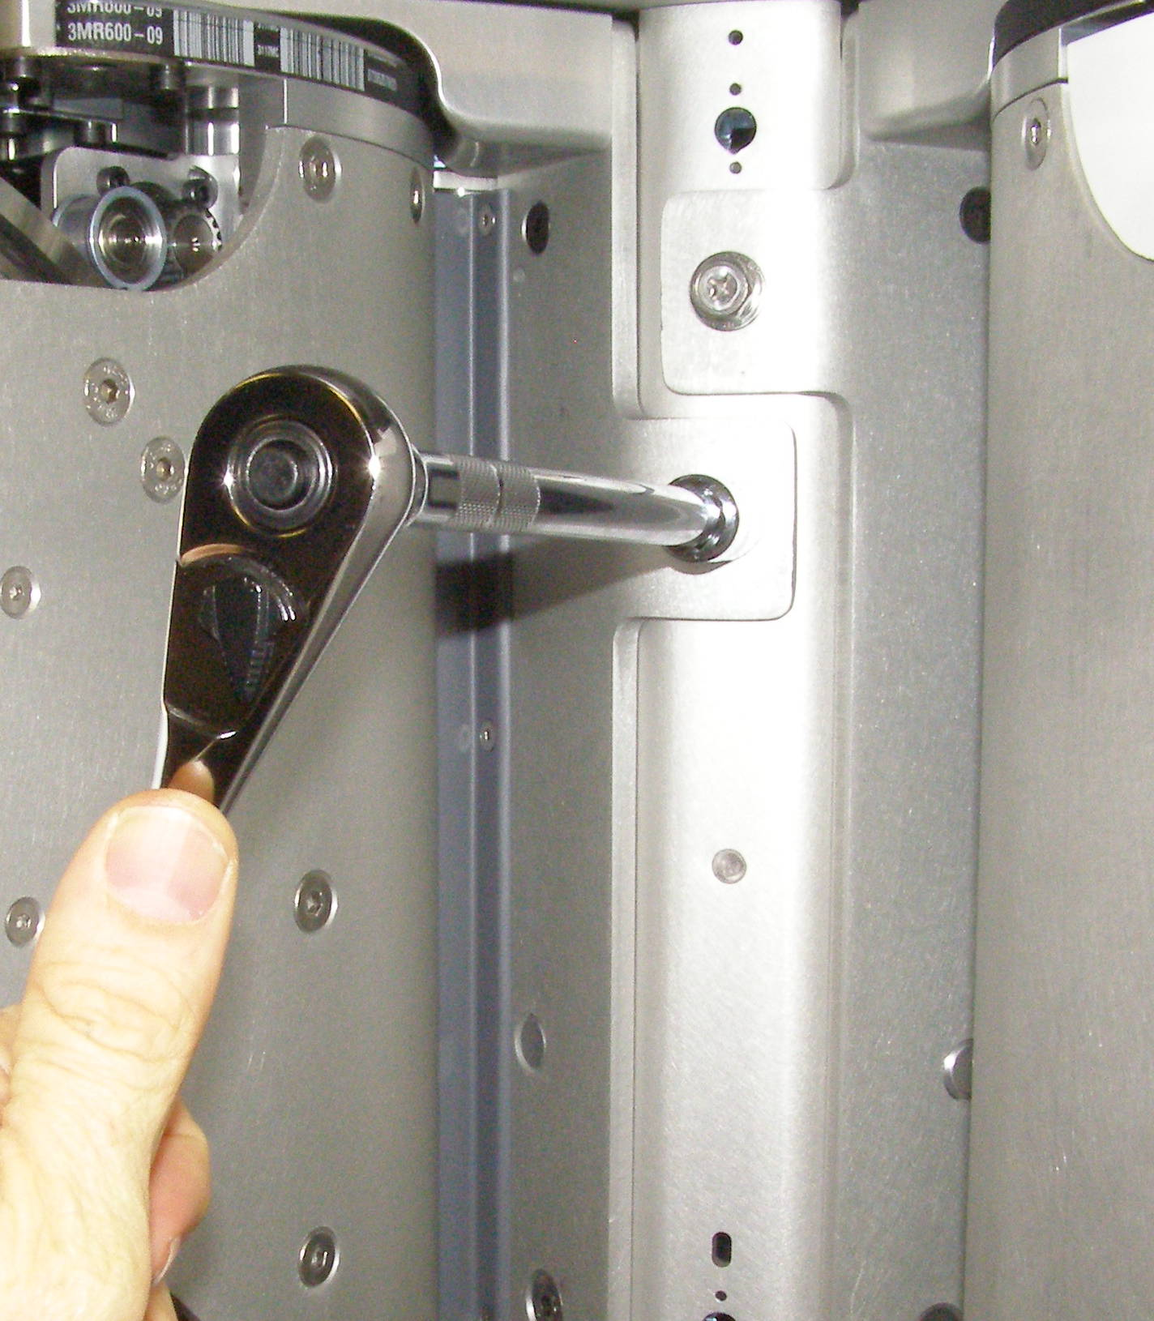
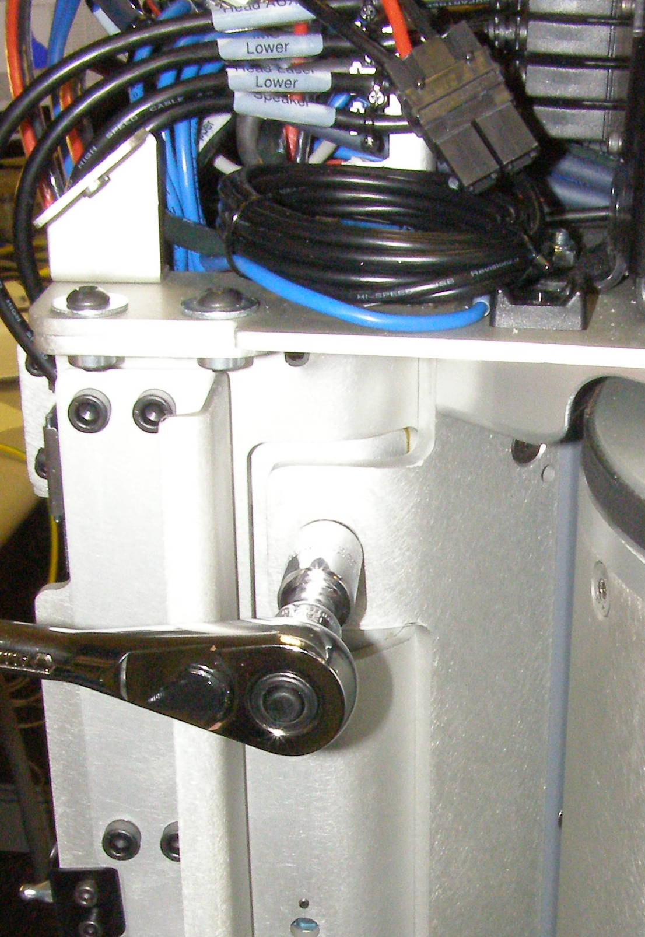
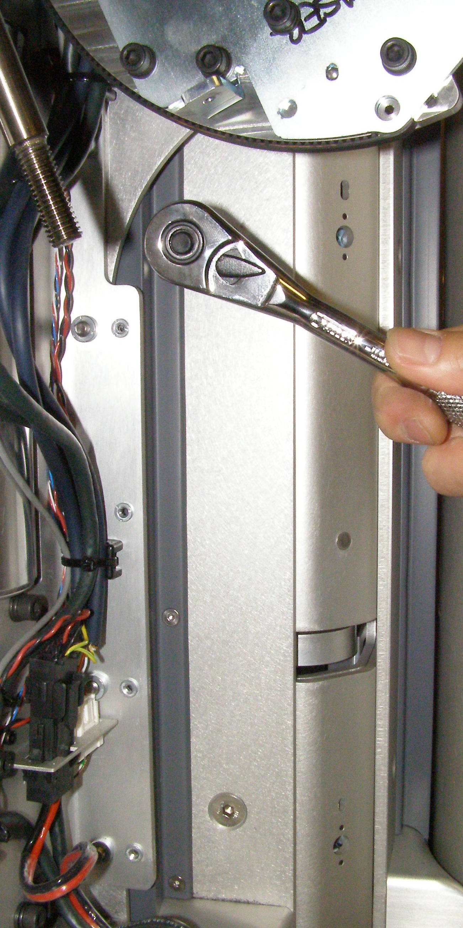
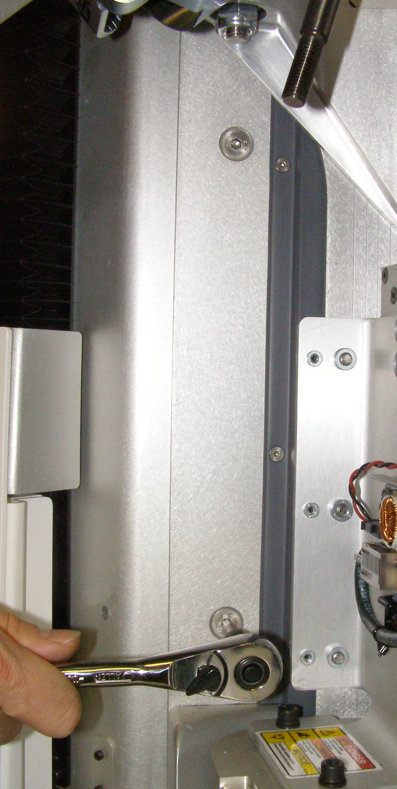
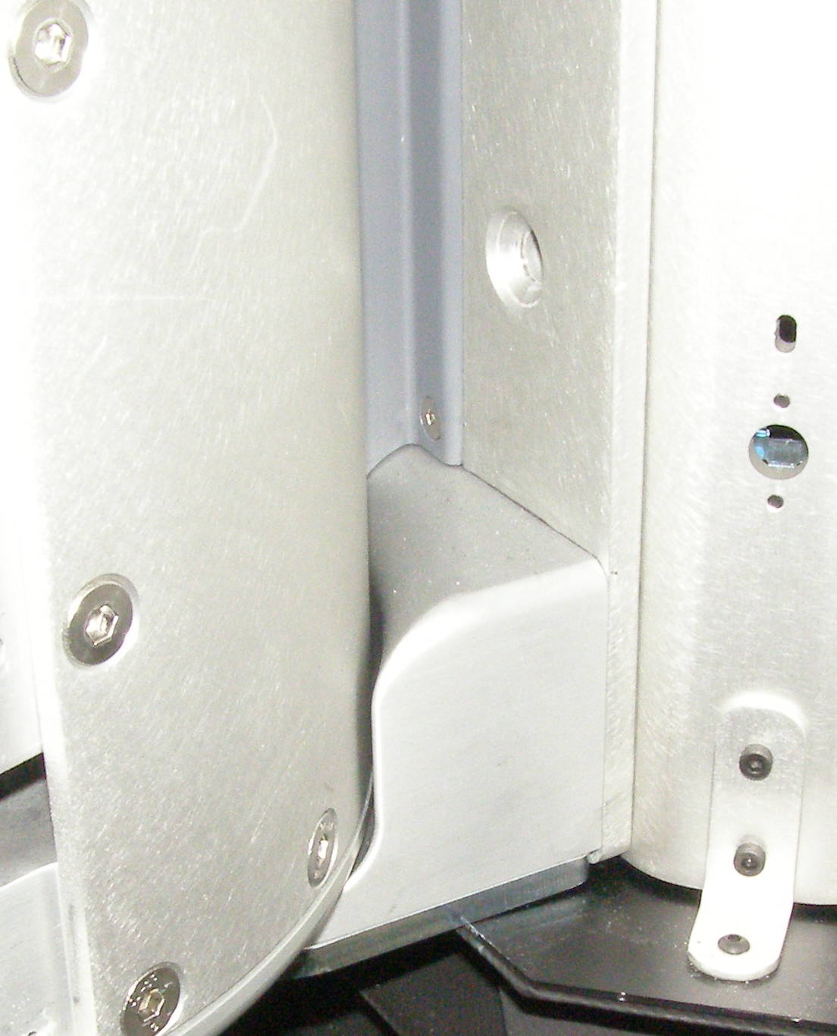
Shoulder Removal (2)
  Have one person support the Shoulder so it will not fall of when the bolts are released. Using the 13mm socket with the 8 inch extension and the 3/8 drive ratchet wrench, remove 1 bolt on each side of the Shoulder. 2092-25 (Fig 10,11)
  Using two people, one to lift and one to guide, carefully extract the Shoulder sideways not letting it fall on the lower Bellows. (Fig 12)
Fig 7
Fig 10
  Rotate the Shoulder to gain access to the mounting screws, using the 5mm bit with the hex to 3/8 drive adapter and the 3/8 drive ratchet wrench, remove 2 Flathead screws on each side of the Shoulder. 3067-20 (Fig 8,9)
Fig 8
Fig 9
Fig 11

Slide 4
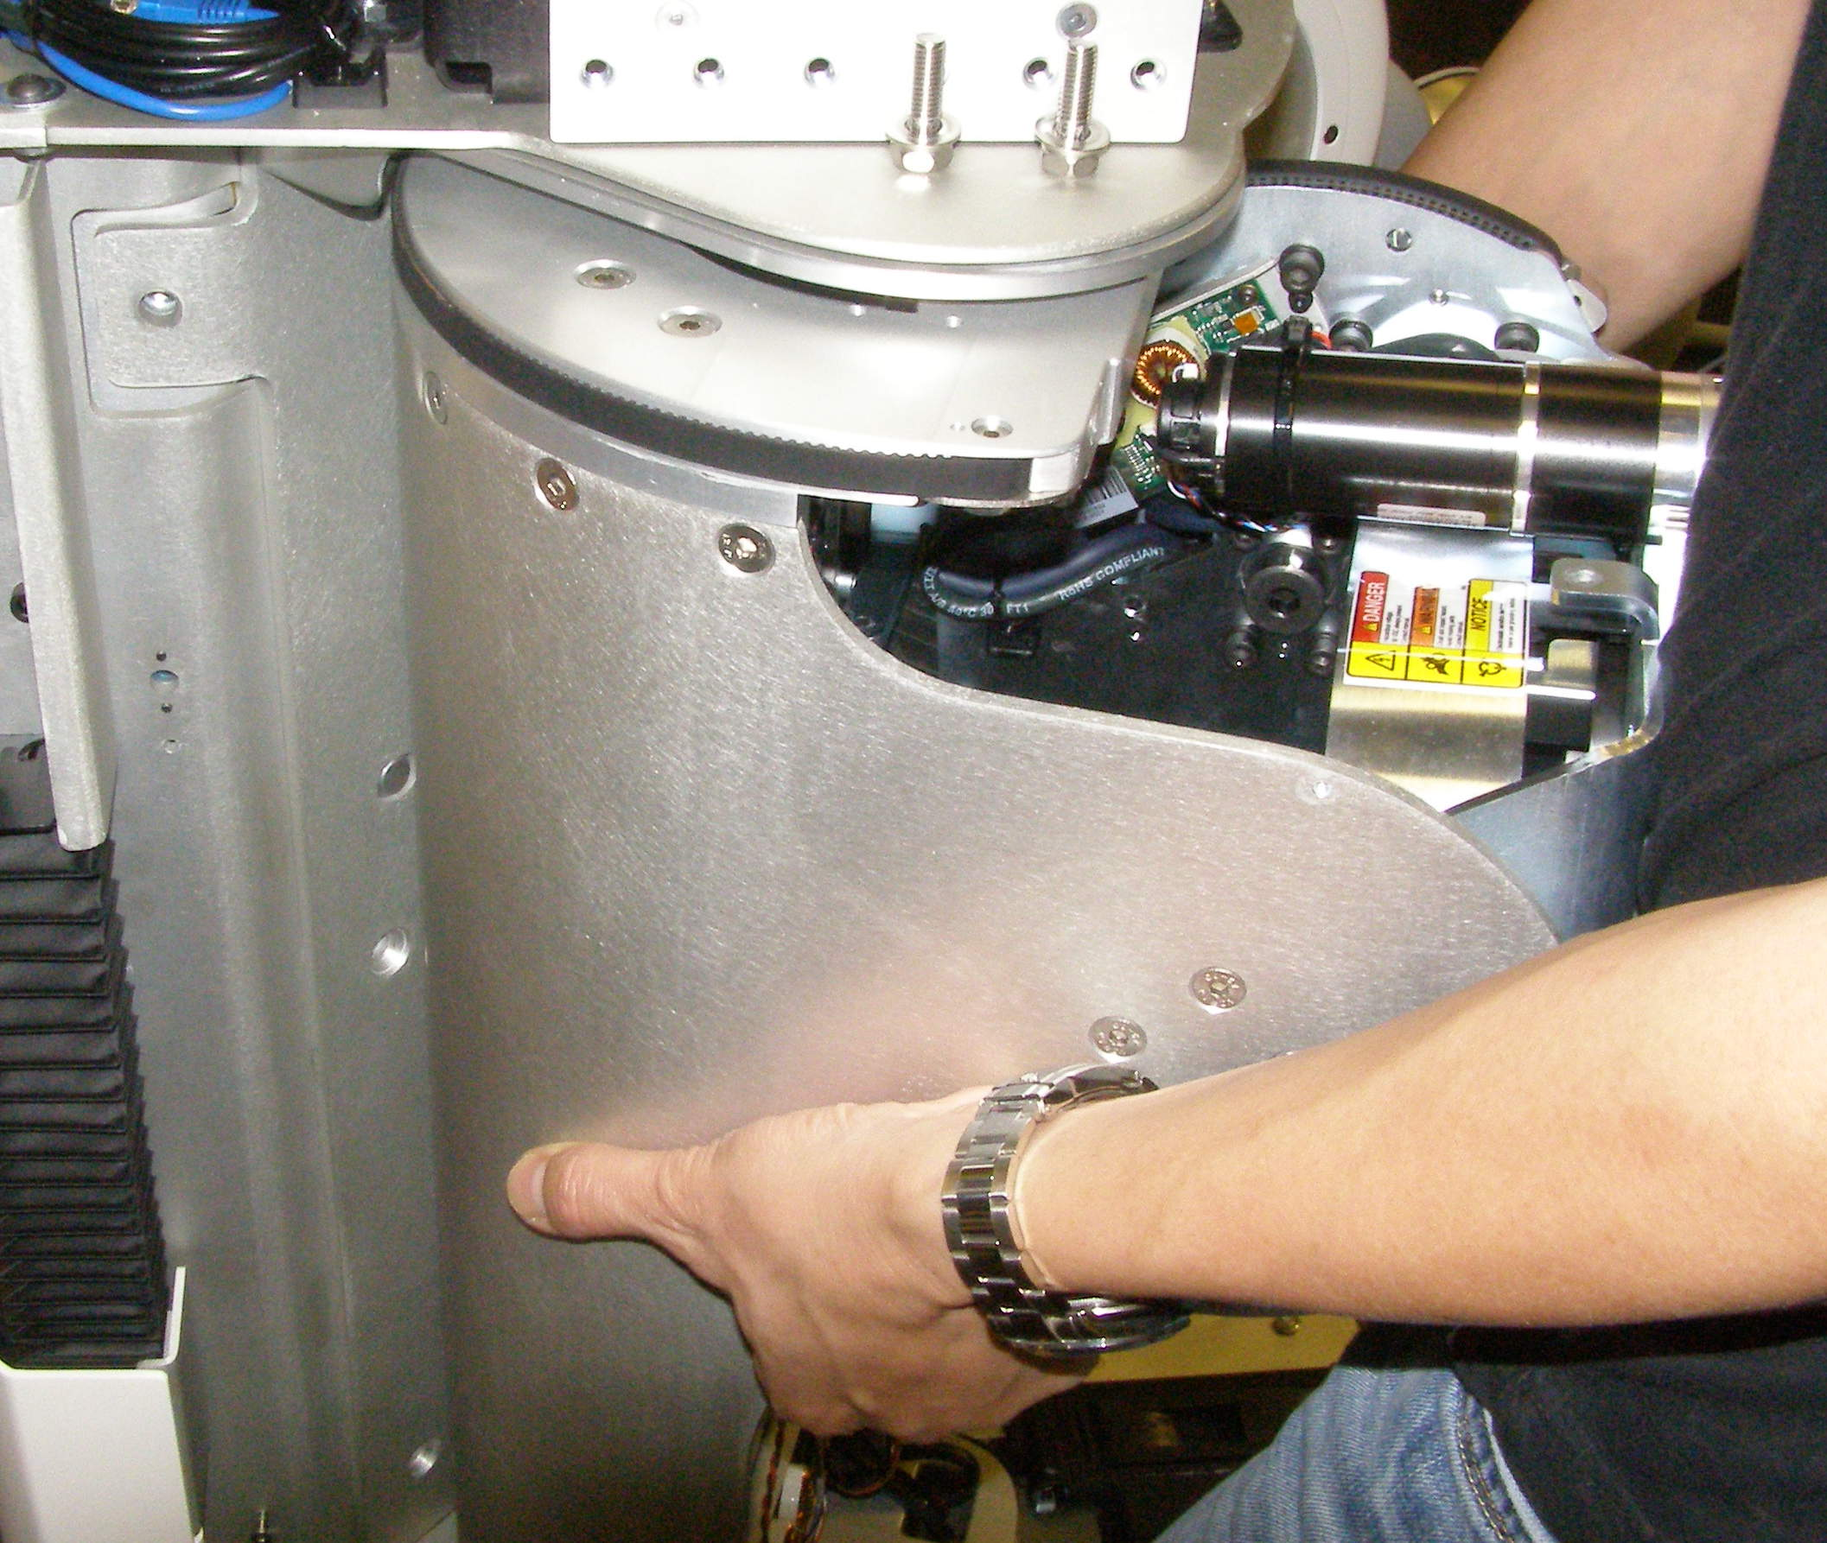
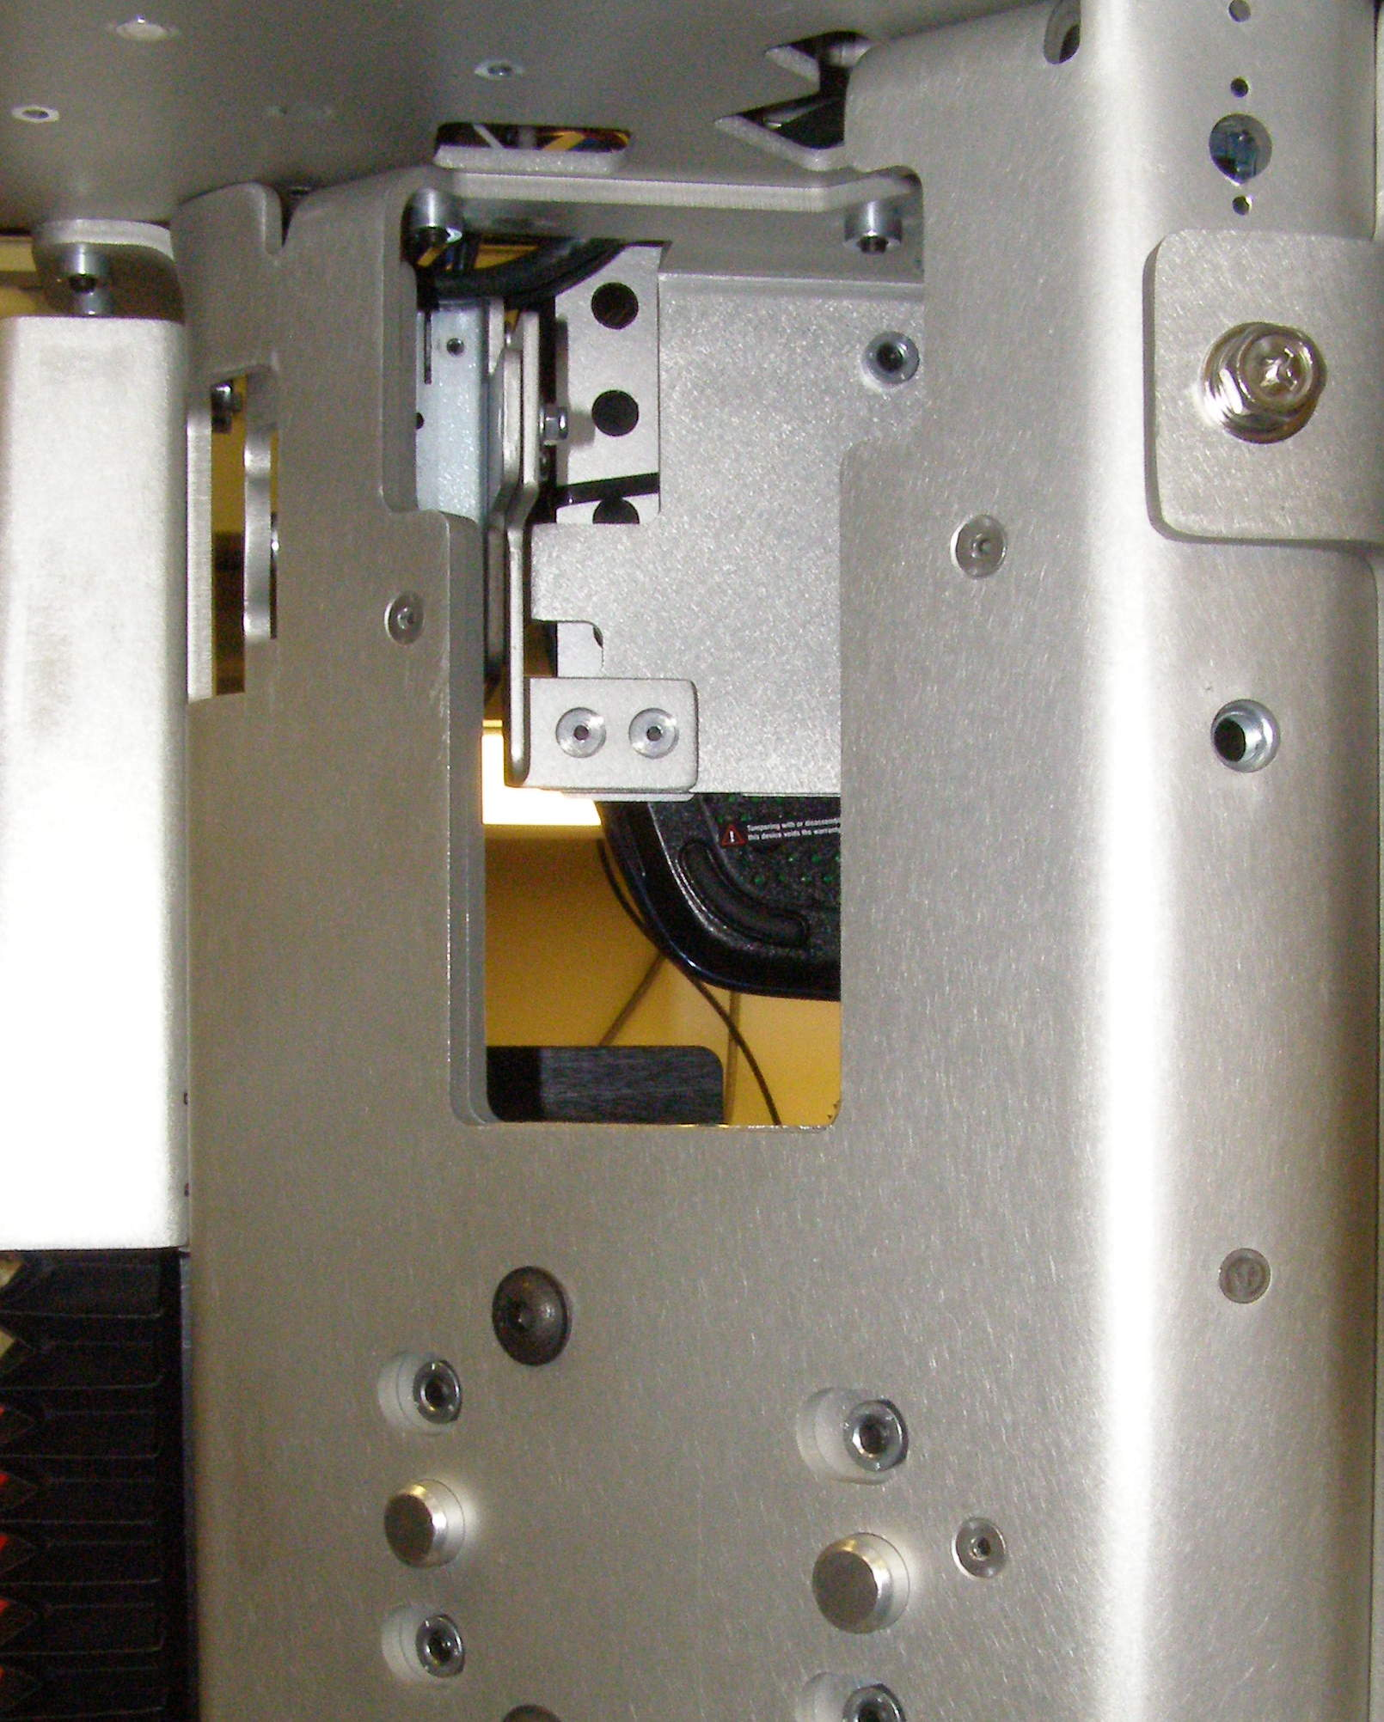
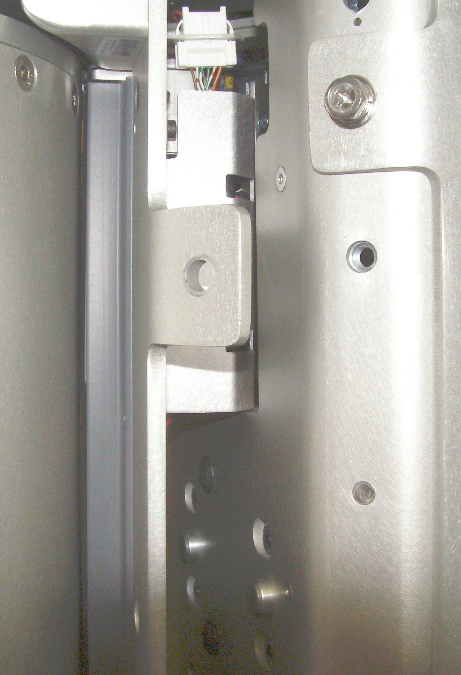
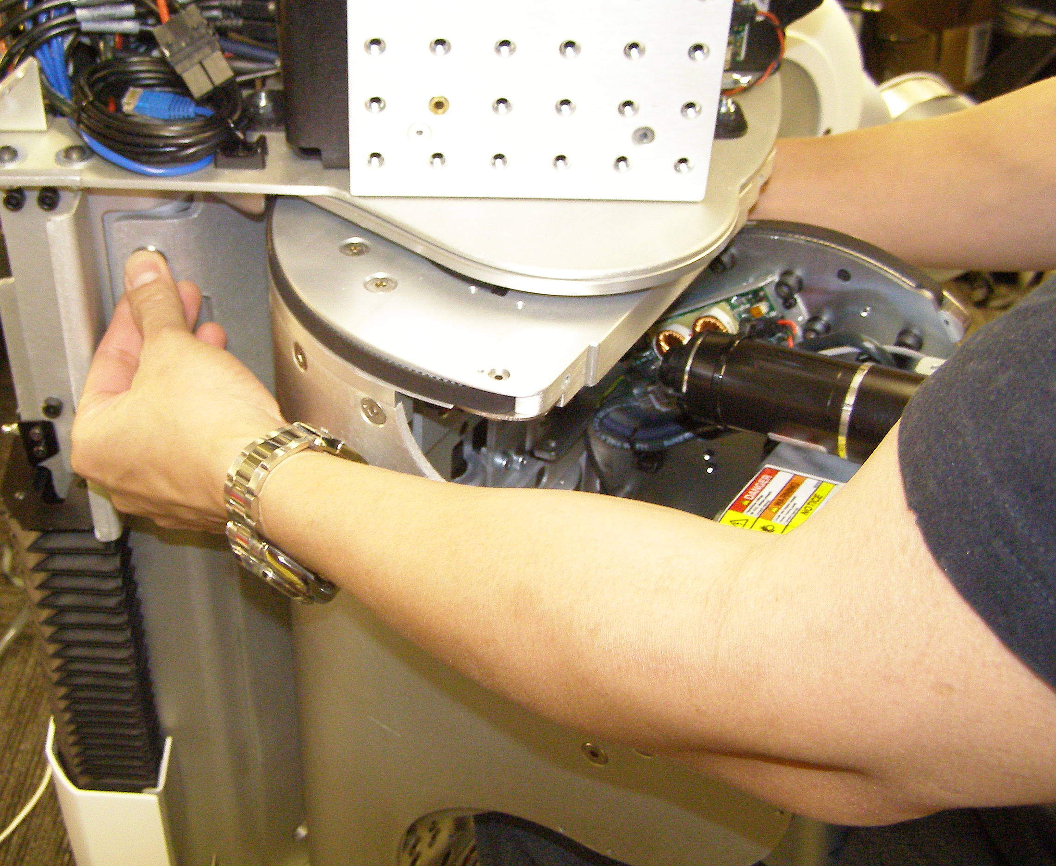
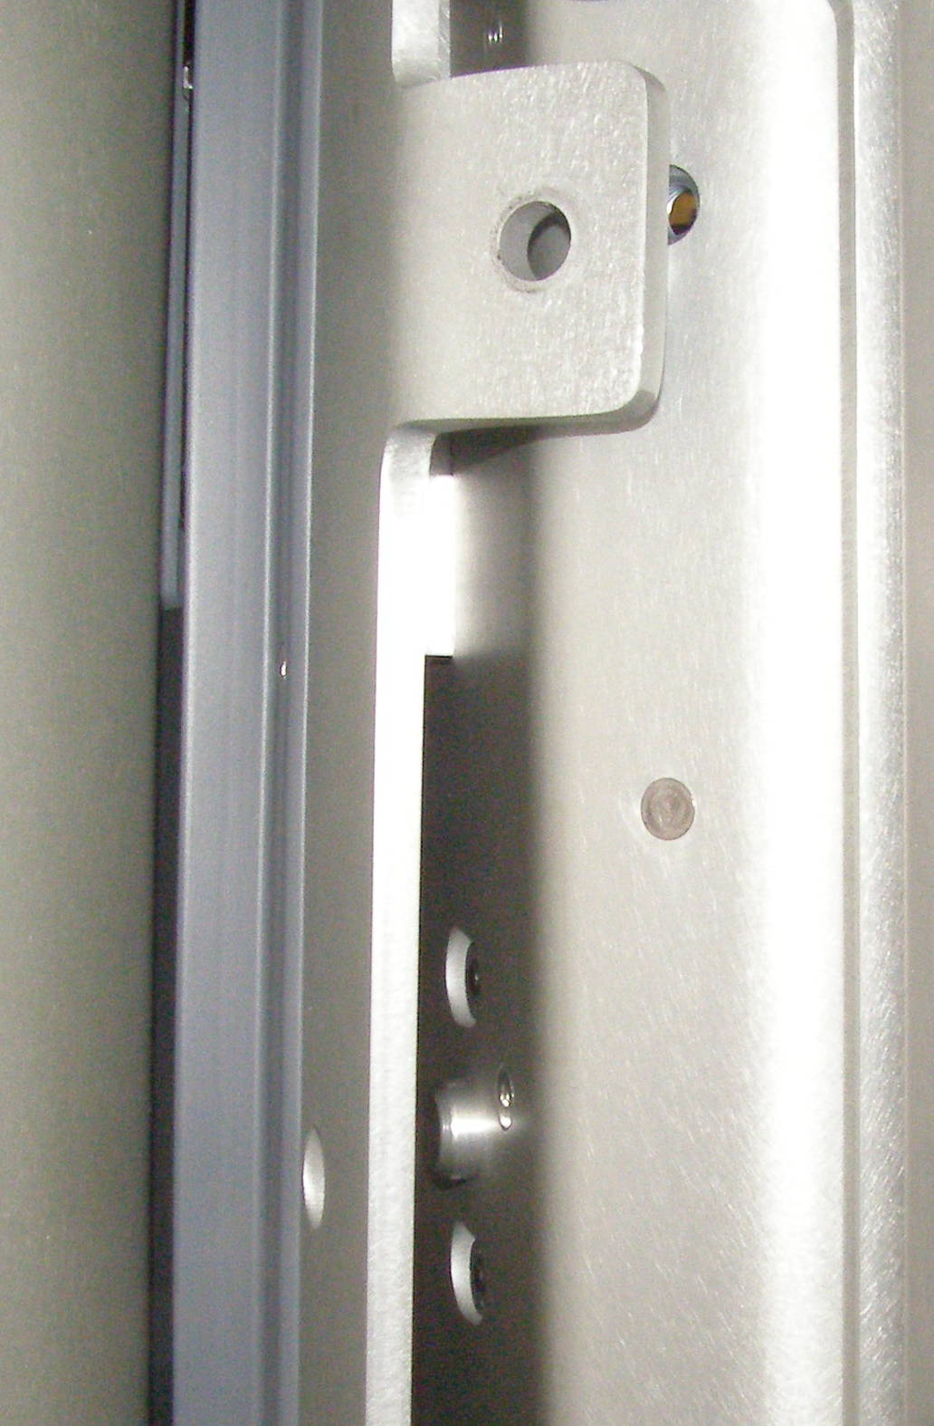
Shoulder Install
Shoulder, Install (requires 2 people)
  With 2 people lifting, offer the Shoulder up to the Robot being careful to keep the top of the Shoulder just under the Head shelf. The MCB assembly and it's shield must fit into the space at the top, and the Shoulder must fit on the 2 alignment studs as shown. Be careful that the Shoulder clears the bottom Bellows, you may have to push the Bellows down slightly. (Fig 1-4)
  With one person holding the Shoulder in place, using Locktite 248, install the 2 upper bolts as far as possible by hand so as to keep the Shoulder from falling off. With these 2 bolts in place the Shoulder will be supported by the 2 alignment studs.
  (Fig 5,6)
Alignment Stud
Fig 1
Fig 5
Alignment Stud
MCB Assembly
Fig 2
Fig 4
Fig 6
  Using Loctite 248, combine the 5mm bit with the the hex to 3/8 drive adapter, and the Titan torque wrench, install the lower 4 mounting screws and torque to 28Nm.
  Using the 13mm socket with the 8 inch extension and the Titan torque wrench, torque the bolts to 28Nm.
  Plug the the 3 cables into place using the Needle Nose pliers.
  Follow the Upper Arm installation to complete the Shoulder assembly.
Fig 3

